Slide 1
Finding the best hotels in the best areas – costumer tailored

Slide 2
People have no time to spend on searching
The searching procedure of hotels can be very frustrating.
You don't really know the city and where is the best places for you to stay
It can take a lot of time to find a hotel which provides you the best deal for your stay.
Costumers need to be close to what they like.

Slide 3
Data acquisition and cleaning
City coordinates using Geopy Library
Using Folium library, a map of chosen location will be made.
Using Foursquare API the user will get hotels, ratings and places in a radius of 7 KM from his city of choice.
Files from Foursquare API will be converted to Pandas DataFrame containing all the relevant hotels data. Without irrelevant columns.
Cluster of hotels + nearby Places using K-Means Algorithm.
30 hotels in total.
12 hotels after cleaning

Slide 4
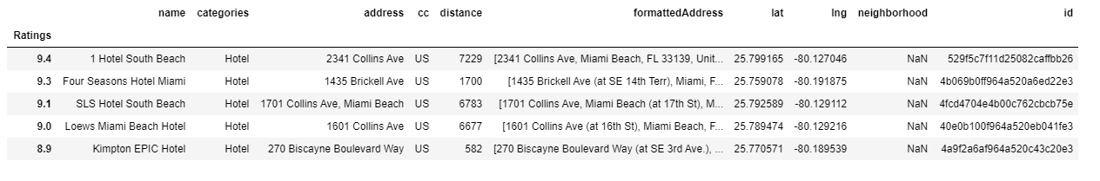
Sample results
Hotel information and rating

Slide 5
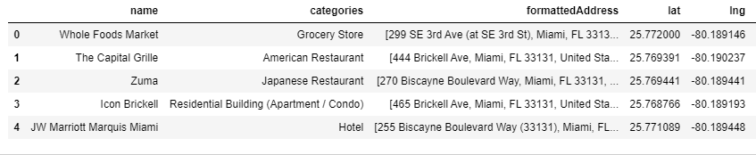
Places next to hotels

Slide 6
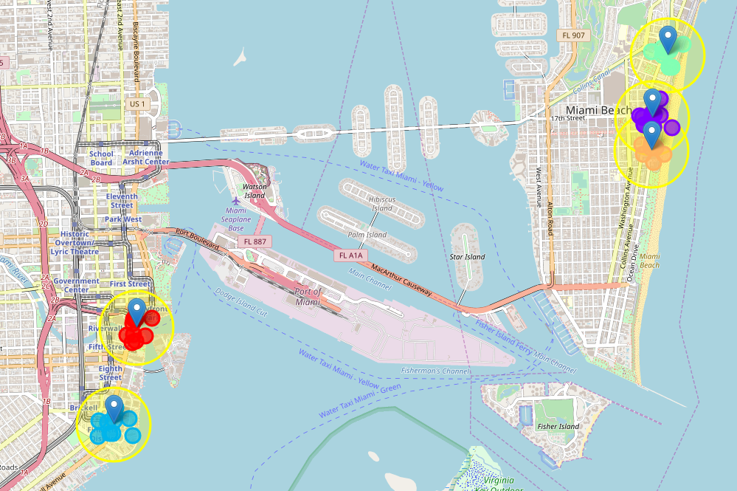
Top 5 hotels + places: Clusters

Slide 7
Conclusion
The aim was to help Tourists in narrowing down the search for optimal location for stay.
Recommendation of the Best Hotels in a City together with nearby places was achieved.
Results consider hotel’s rating + popular places.
User satisfaction guaranteed!
In order to improve the model:
More hotel info: prices, services etc.
Division by costumer’s preferences.
More info about transportation.

